Slide 1
Welcome to CS4222 PSLG!
With Robert and Jakub

Slide 2

Java 2D Arrays​
A 2D array is an array of arrays and are useful when you want to store data as a tabular form, like a table with rows and columns​
​
To create a two-dimensional array, add each array within its own set of curly braces:​
int[][] myNumbers = { {1, 2, 3, 4}, {5, 6, 7} };​
​
Access:​
System.out.println(myNumbers[1][2]); ​
// Outputs 7​

Slide 3
Problem 1
Declare, initialize and fill a 2D array capable of storing integers with dimensions 4 rows by 6 columns.

Slide 4
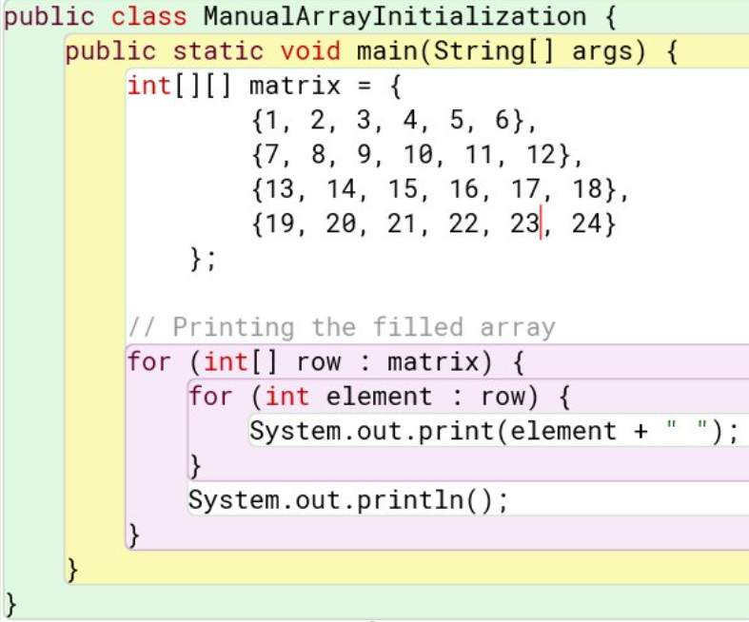
Answer:

Slide 5
Problem 2
Write a Java program to calculate and print the sum of all elements in a 2D array.

Slide 6
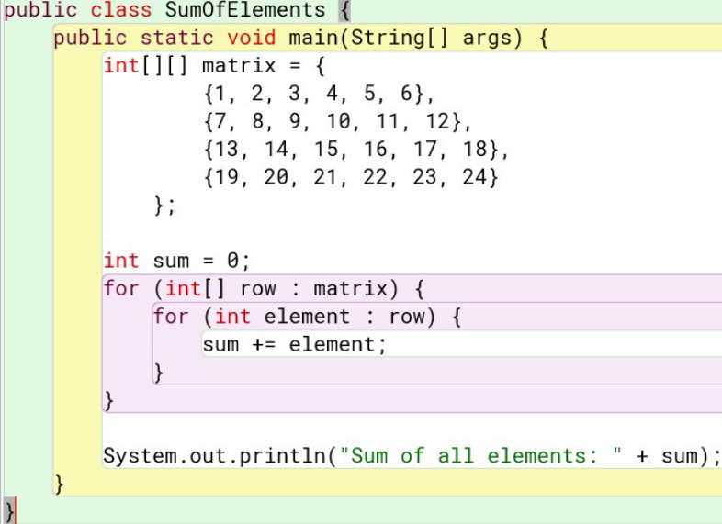
Answer:

Slide 7
Problem 3
Write a Java program to calculate and print the average value of all elements in a 2D array.

Slide 8
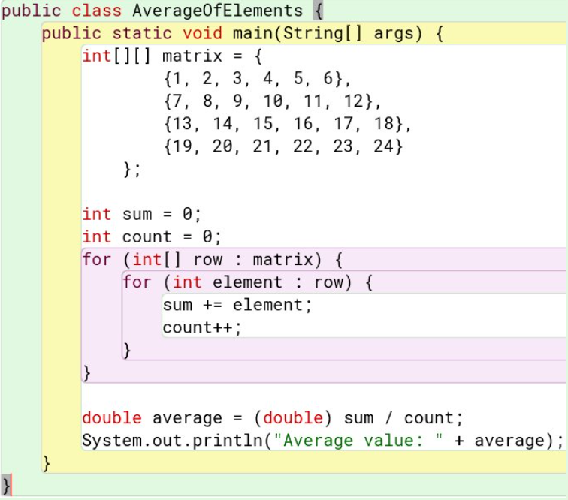
Answer:

Slide 9
Problem 4
Write a Java program to find and print the maximum element in a 2D array.

Slide 10
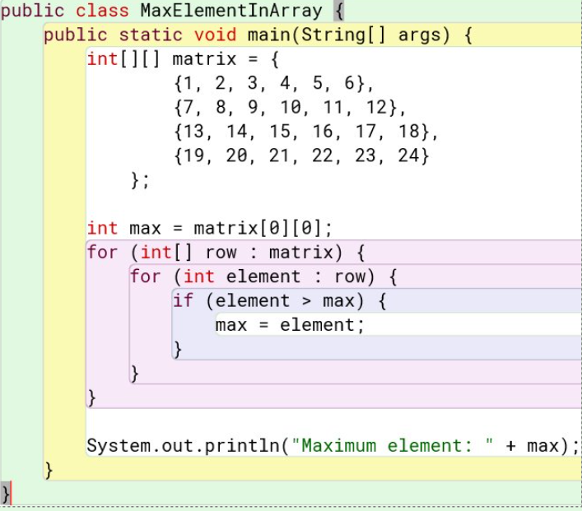
Answer:

Slide 11
Problem 5
Write a java program to take a 2D array and resize it by half (Shrink it to half its original size)

Slide 12
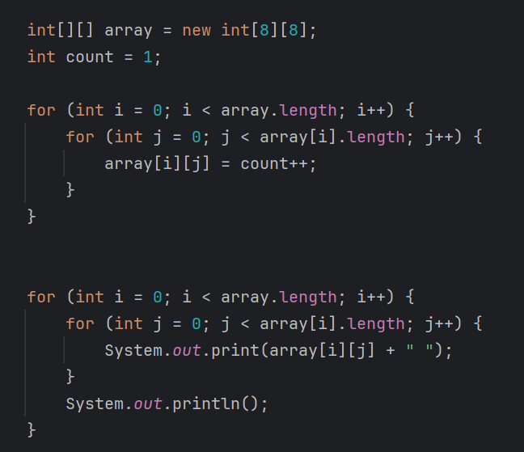
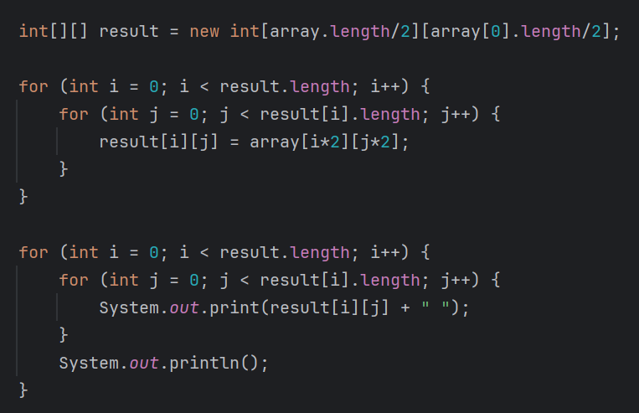
Answer:

Slide 13

Thank you for coming!

